Slide 1


APEX INSTITUTE OF TECHNOLOGY
DEPARTMENT OF COMPUTER SCIENCE & ENGINEERING
MACHINE LEARNING (21CSH-286)
Faculty: Prof. (Dr.) Vineet Mehan (E13038)
Lecture - 1
Basics of Machine Learning
DISCOVER . LEARN . EMPOWER

Slide 2
DBMS: Course Objectives
COURSE OBJECTIVES
The Course aims to:
Understand and apply various data handling and visualization techniques.
Understand about some basic learning algorithms and techniques and their applications, as well as general questions related to analysing and handling large data sets.
To develop skills of supervised and unsupervised learning techniques and implementation of these to solve real life problems.
To develop basic knowledge on the machine techniques to build an intellectual machine for making decisions behalf of humans.
To develop skills for selecting suitable model parameters and apply them for designing optimized machine learning applications.

Slide 3
COURSE OUTCOMES
On completion of this course, the students shall be able to:-
CO1 | Understand machine learning techniques and computing environment that are suitable for the applications under consideration.

Slide 4
Unit-1 Syllabus
Unit-1 | Introduction to Machine Learning
Introduction to Machine Learning | Definition of Machine Learning, Working principles of Machine Learning; Classification of Machine Learning algorithms: Supervised Learning, Unsupervised Learning, Reinforcement Learning, Semi-Supervised Learning; Applications of Machine Learning.
Data Pre-Processing and Feature Extraction | Data Sourcing and Cleaning, Handling Missing data, Encoding Categorical data, Feature Scaling, Handling Time Series data; Feature Selection techniques, Data Transformation, Normalization, Dimensionality reduction
Data Visualization | Data Frame Basics, Different types of analysis, Different types of plots, Plotting fundamentals using Matplotlib, Plotting Data Distributions using Seaborn.

Slide 5
SUGGESTIVE READINGS
TEXT BOOKS:
There is no single textbook covering the material presented in this course. Here is a list of books recommended for further reading in connection with the material presented:
T1: Tom.M.Mitchell, “Machine Learning, McGraw Hill International Edition”.
T2: Ethern Alpaydin,” Introduction to Machine Learning. Eastern Economy Edition, Prentice Hall of India, 2005”.
T3: Andreas C. Miller, Sarah Guido, Introduction to Machine Learning with Python, O’REILLY (2001).
REFERENCE BOOKS:
R1 Sebastian Raschka, Vahid Mirjalili, Python Machine Learning, (2014)
R2 Richard O. Duda, Peter E. Hart, David G. Stork, “Pattern Classification, Wiley, 2nd Edition”.
R3 Christopher Bishop, “Pattern Recognition and Machine Learning, illustrated Edition, Springer, 2006”.

Slide 6
Index
Artificial Intelligence (AI)
History
Machine Learning(ML)
Deep Learning (DL)
Best Programming Language for Machine Learning
Machine Learning in our daily life

Slide 7
Artificial Intelligence
Intelligence is an inherent part of human brain.
When we try to replicate this intelligence in machines then it is called Artificial Intelligence(AI).
AI is making a new revolution in the world by making intelligent machines.

Slide 8
AI Definition
“It is a branch of computer science by which we can create intelligent machines which can behave like a human, think like humans, and able to make decisions.”
Artificial Intelligence exists when a machine can have human based skills such as learning, reasoning, and solving problems.

Slide 9
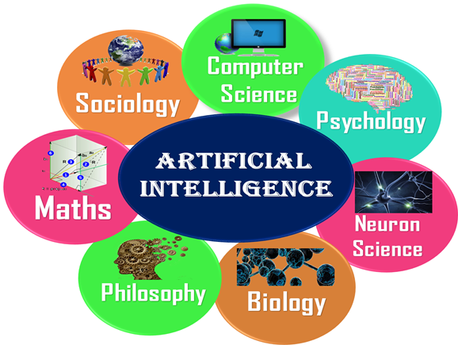
Disciplines associated with AI

Slide 10
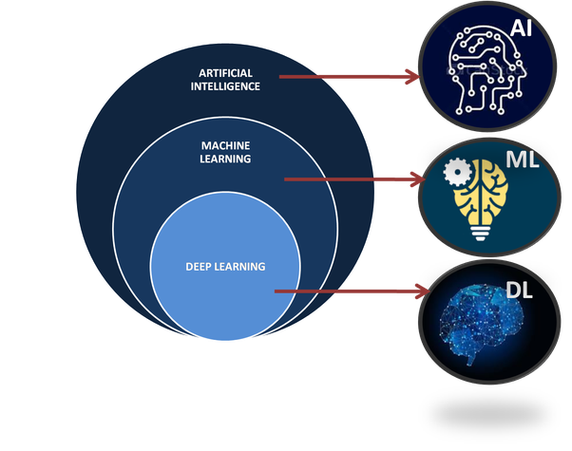
Subdomains of AI

Slide 11
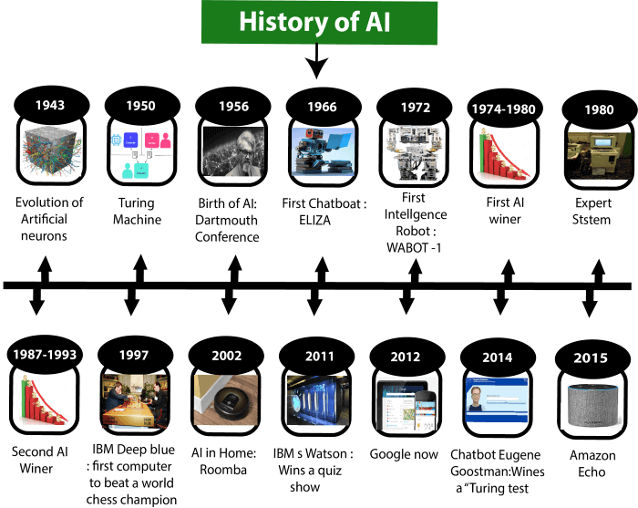
History of AI

Slide 12
Evolution of Artificial Intelligence (1943-1952)
Year 1943: The first work which is now recognized as AI was done by Warren McCulloch and Walter pits in 1943. They proposed a model of artificial neurons.
Year 1949: Donald Hebb demonstrated an updating rule for modifying the connection strength between neurons. His rule is now called Hebbian learning.
Year 1950: The Alan Turing who was an English mathematician and pioneered Machine learning in 1950. Alan Turing publishes "Computing Machinery and Intelligence" in which he proposed a test. The test can check the machine's ability to exhibit intelligent behavior equivalent to human intelligence, called a Turing test.

Slide 13
The birth of Artificial Intelligence (1952-1956)
Year 1955: An Allen Newell and Herbert A. Simon created the "first artificial intelligence program "Which was named as "Logic Theorist". This program had proved 38 of 52 Mathematics theorems, and find new and more elegant proofs for some theorems.
Year 1956: The word "Artificial Intelligence" first adopted by American Computer scientist John McCarthy at the Dartmouth Conference. For the first time, AI coined as an academic field.

Slide 14
The golden years-Early enthusiasm (1956-1974)
Year 1966: The researchers emphasized developing algorithms which can solve mathematical problems. Joseph Weizenbaum created the first chatbot in 1966, which was named as ELIZA.
Year 1972: The first intelligent humanoid robot was built in Japan which was named as WABOT-1.

Slide 15
The first AI winter (1974-1980)
The duration between years 1974 to 1980 was the first AI winter duration.
AI winter refers to the time period where computer scientist dealt with a severe shortage of funding from government for AI researches.
During AI winters, an interest of publicity on artificial intelligence was decreased.

Slide 16
A boom of AI (1980-1987)
Year 1980: After AI winter duration, AI came back with "Expert System".
Expert systems were programmed that emulate the decision-making ability of a human expert.
In the Year 1980, the first national conference of the American Association of Artificial Intelligence was held at Stanford University.

Slide 17
The second AI winter (1987-1993)
The duration between the years 1987 to 1993 was the second AI Winter duration.
Again Investors and government stopped in funding for AI research as due to high cost but not efficient result.
The expert system such as XCON was very cost effective.

Slide 18
The emergence of intelligent agents (1993-2011)
Year 1997: In the year 1997, IBM Deep Blue beats world chess champion, Gary Kasparov, and became the first computer to beat a world chess champion.
Year 2002: for the first time, AI entered the home in the form of Roomba, a vacuum cleaner.
Year 2006: AI came in the Business world till the year 2006. Companies like Facebook, Twitter, and Netflix also started using AI.

Slide 19
Deep learning, big data and artificial general intelligence (2011-present)
Year 2011: In the year 2011, IBM's Watson won jeopardy, a quiz show, where it had to solve the complex questions as well as riddles. Watson had proved that it could understand natural language and can solve tricky questions quickly.
Year 2012: Google has launched an Android app feature "Google now", which was able to provide information to the user as a prediction.
Year 2014: In the year 2014, Chatbot "Eugene Goostman" won a competition in the infamous "Turing test."

Slide 20
Deep learning, big data and artificial general intelligence (2011-present)
Year 2018: The "Project Debater" from IBM debated on complex topics with two master debaters and also performed extremely well.
Google has demonstrated an AI program "Duplex" which was a virtual assistant and which had taken hairdresser appointment on call, and lady on other side didn't notice that she was talking with the machine.

Slide 21
AI (Now)
Now AI has developed to a remarkable level.
The concept of AI, ML, Deep learning, big data, and data science are now trending like a boom.
Nowadays companies like Google, Facebook, IBM, and Amazon are working with AI and creating amazing devices.
The future of Artificial Intelligence is inspiring and will come with high intelligence.

Slide 22
Machine Learning
Machine Learning is a part of Artificial Intelligence which can make predictions using pattern and trends recognition in data.
The ML algorithms have self-learning capabilities and do not require human interference for error calculation.
ML algorithms adapt themselves on their own and learn from the previous data to show results for the new data fed into the system and also identify the hidden trends and patterns in the data.

Slide 23
Deep Learning
Deep Learning is a part of Machine Learning.
Deep learning generally is a neural network with 3 or more layers.
Neural network is an attempt to simulate the behavior of human brain, allowing it to learn from large amounts of data.
Deep learning requires large data and thus provide high accuracy. E.g. Virtual Assistant, Autonomous Cars, Chat bots and Face Recognition etc.

Slide 24
What is the Best Programming Language for Machine Learning?
Python
60% programmers still prefer Python because of the numerous libraries it supports.
Alternatively, Matlab, C++, Java, R and Javascript can also be used.

Slide 25
Machine Learning in our daily life
Google Maps for showing the correct path with the shortest route and predicts the traffic conditions.
Google assistant for looking for a particular information.
Alexa (Amazon)
Online cab service price recommendations

Slide 26
Machine Learning in our daily life
Product recommendations on shopping sites like Amazon, Flipcart etc.
Email Spam and Malware Filtering
Automatic Language Translation
Automatic friend tagging suggestion on Facebook etc.

Slide 27
Summary
AI
History
Subdomains
Programming Language
ML in our daily life

Slide 28
Task
Compare and discriminate between AI, ML and Deep Learning (BT-Level5).

Slide 29
REFERENCES
https://www.javatpoint.com/machine-learning
https://www.tutorialspoint.com/machine_learning/index.htm
https://www.simplilearn.com/tutorials/machine-learning-tutorial/what-is-machine-learning?source=sl_frs_nav_playlist_video_clicked

Slide 30

THANK YOU
For queries
Email: vineet.e13038@cumail.in

